Slide 1
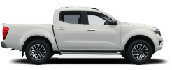
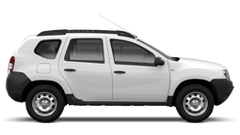
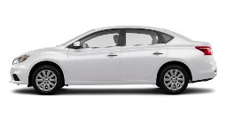
FLEET OPTIMIZATION
OVERVIEW OF CO2 EMISSIONS, SAFETY RATING AND TOTAL COST OF OPERATIONS RATING PER TYPE OF VEHICLES IN IFRC FLEET
FOR FIELD AND/OR SEVERE
ROAD CONDITIONS
NISSAN NAVARA
RENAULT
DUSTER 4x2
FOR URBAN AREAS AND FIELD WITH GOOD ROAD CONDITIONS
TOYOTA
LAND CRUISER
RENAULT DUSTER 4x4
NISSAN
SENTRA
TOTAL COST OF OPERATION
0.47
0.41
0.37
0.37
0.35
FIGURES USING 2020 IFRC GLOBAL FLEETWAVE DATA
CO2 EMISSIONS RATING
CO2 EMISSIONS ARE ONE OF THE MAIN DRIVERS OF GLOBAL CLIMATE CHANGE
SAFETY
RATING
3
4
3
3
5
SAFETY IS ALWAYS OUR PRIORITY!
IFRC
PURCHASE
GUIDANCE
FOR SPECIFIC OPERATIONAL NEEDS
FOR SPECIFIC OPERATIONAL NEEDS
RECOMMENDED
RECOMMENDED
RECOMMENDED
BASED ON ALL PARAMETERS
ABOVE
RESOURCES: * DATA EXTRACTED FROM FLEETWAVE, ICRC CARBON ACCOUNTING TOOL AND EURO NCAP AND ANCAP WEBPAGE

